Slide 1
BOTN 104 Lecture 7
Primary Root Development: activities of root apical meristem; root hair and lateral root development; root structure and functions

Slide 2
Introduction
The first embryonic structure that emerges from the seed is the Radicle
The radicle contains a region of specialized tissues at the apex called the root apical meristem
These meristematic cells undergo division to produce many cells which enlarge, differentiate and bring about elongation of the root

Slide 3
As cells are added to the root tip by repeated cell divisions, a young root elongates
This results in a separation of the apical meristem from the initially formed cells
The elongation and differentiation of earlier formed cells leads to the formation of a recognizable primary root structure

Slide 4
The primary root comprises of the following developmental regions (starting from tip): the root cap, zone of active cell division, zone of cell elongation, and zone of cell maturation
The root cap and zone of active cell division are the regions that actually move through the soil. After cells start to elongate and mature, no further extension of that part of the root takes place, making it ‘fixed in size’ for the rest of its life

Slide 5
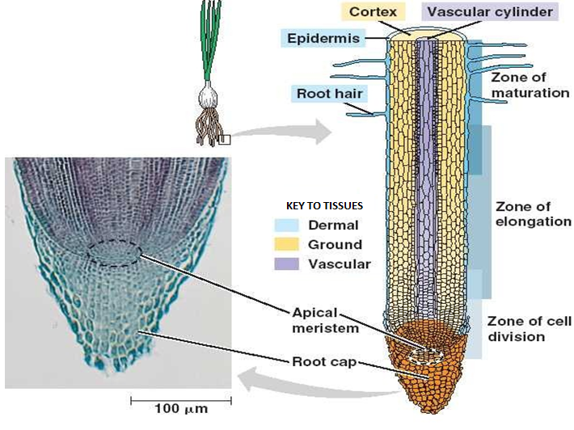

Slide 6
Root cap
The root cap is a cup-shaped, loosely cemented mass of parenchyma cells that cover the tip of the root. As the root cap penetrates the soil, the surface cells are lost due to friction between the root cap and the soil particles. These are replaced by new cells formed by the apical meristem.
The root cap protects the cells of the root apical meristem from abrasion and assists the root in penetrating the soil. The root cap produces a slimy substance which enables the root to penetrate through the ground. This slimy substance consists of mucopolysaccharide.

Slide 7
The mucopolysaccharide
Lubricates the roots.
Protects the root cells from drying out.
Glues soil particles to the roots thereby improving the soil-root contact and facilitating water movement from the soil into the plant.
Influences ion uptake.
Contains materials that are inhibitory to roots of other species.
Attracts beneficial soil microorganisms.
The primary root cap has the ability to detect gravity and grows in its direction; hence it grows downwards into the soil anchoring the roots and accessing nutrients and water in the soil

Slide 8
Zone of cell division
The root apical meristem lies within the zone of cell division, which is surrounded by the root cap. The apical meristematic cells divide continually, giving rise to the cells that make up the rest of the root.
The zone of cell division consists of two regions, an outer region where the cells divide rapidly and an inner region where the cells divide more slowly - known as the quiescent center.
The rapidly dividing apical cells give rise to columns of cells arranged parallel to the root axis.

Slide 9
Zone of cell division (cont’d)
The cells of the root apical meristem are small, cuboidal cells with dense cytoplasm, devoid of vacuoles and with relatively large nuclei.
These cells give rise to the three primary meristems: protoderm, which forms the epidermis; procambium, which produces xylem and phloem; and the ground meristem, which produces the cortex.
As the new cells are formed, previously formed cells are pushed further away from the region of cell division and hence one can find along the root length, cells of different ages and at different stages of development.

Slide 10
Zone of cell elongation
Above the zone or region of cell division, lies cells which are no longer dividing and have began to elongate. This part of the root is called the zone or region of cell elongation.
Increase in root length is mostly due to the extension growth of cells in this region. The cells in this zone stretch due to uptake of water and cell wall extension.
Cellular expansion in this zone is responsible for pushing the root cap and root apex downwards into the soil.
The advantage of this arrangement is that only a small part of the root is pushed through the soil at any time.
These elongating cells also reach their mature size and extension growth stops

Slide 11
Zone of maturation
The elongated cells differentiate to form the region of maturation. These cells assume the characteristics they require for the functions they have to perform. This is the process of differentiation.
The outer layer of cells become the dermal tissue - epidermis. The cells of the epidermis form a single layer and are rectangular in shape.
Some of these cells undergo unequal cell division. The smaller cells then form protrusions on the outer surface which extend to form the root hairs.
The shortest root hairs are nearest the root cap. Further back, they increase in length until the maximum length is reached.
Root hairs seldom exceed 1 cm (0.4 inch) in length. The great numbers of root hairs (200 – 300 per mm² of epidermis) cause them to increase the absorptive surface of roots for obtaining water and nutrients.
An individual root hair lives for only a day or two, but new ones form constantly as new elongated cells differentiate.

Slide 12
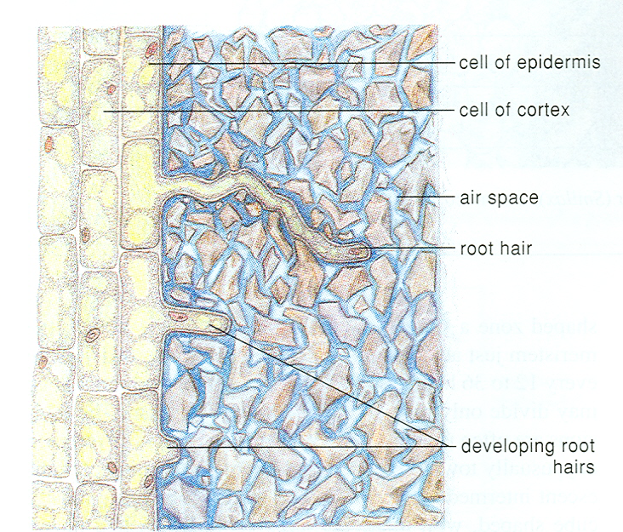
Root Hair

Slide 13
The cells internal to the epidermis differentiate to form the cortex and vascular tissue.
The cells that form the cortex have large vacuoles, and less dense cytoplasm.
The innermost layer of the cortical cells are rectangular and form the endodermis. They contain suberin in their walls. The suberin is fatty material that inhibits flow of water and nutrients from the soil to the innermost tissues of the root.
Internal to the cortical tissue is the vascular tissue. The cells forming the vascular tissues initially have small vacuoles and denser cytoplasm. The vascular tissues consist of xylem, phloem, procambium and pericycle.

Slide 14
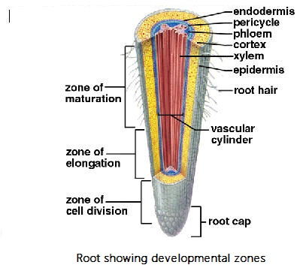

Slide 15
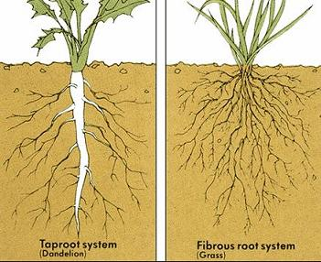
In dicots, the primary root becomes the dominant root and grows directly downwards. It is known as the tap root. Beyond the region of cell elongation branch roots called lateral roots form on the tap roots. Older lateral roots occur close to the base of the root whilst younger ones occur near the root tip.
In monocots the primary root has a short life and is replaced by adventitious roots and their laterals. This forms the fibrous root system. In this system no one root is dominant.

Slide 16
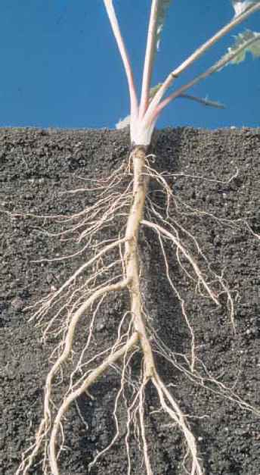
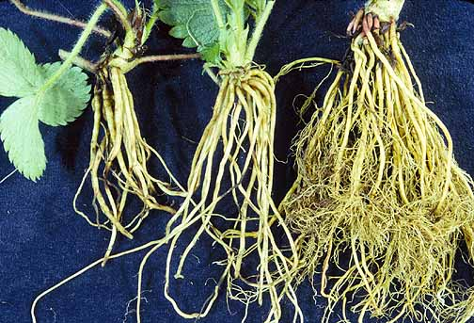
The tap root penetrates deeper into the soil than the fibrous roots. Plants with tap roots are therefore able to obtain water from greater depths in the soil.
Fibrous roots are shallower. However they hold on to soil more firmly and are therefore well suited for checking and preventing soil erosion.

Slide 17
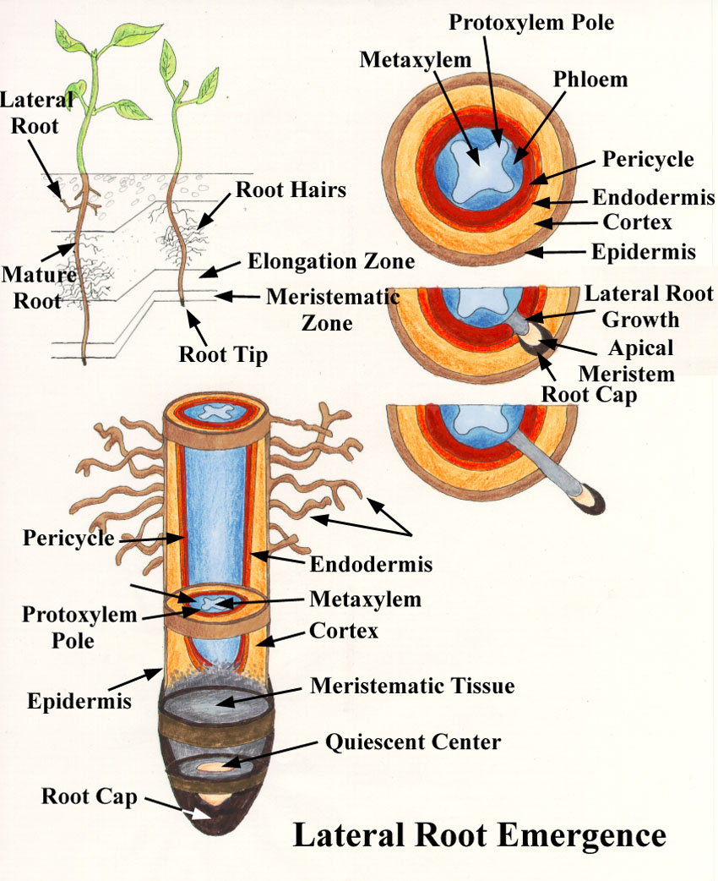
Development of lateral roots
The lateral roots develop from cells that occur deep within the root – pericycle cells. The pericycle cells and also cells within the endodermis de-differentiate i.e. they change from being mature and become meristematic again. This group of dividing cells, next to the vascular tissue, pushes its way through the cortex and is known as the root primordium

Slide 18
The root primordium differentiates into apical meristem, root cap, protoderm, ground meristem, and procambium.
As in the main root, the primary meristems give rise to epidermis, cortex and vascular tissue.
Cell division and cell elongation leads to increase in length of lateral roots which eventually breaks through the cortex and epidermis of the main root protruding from the root surface.
The lateral root is endogenous in origin because it arises from deep seated tissues.

Slide 19
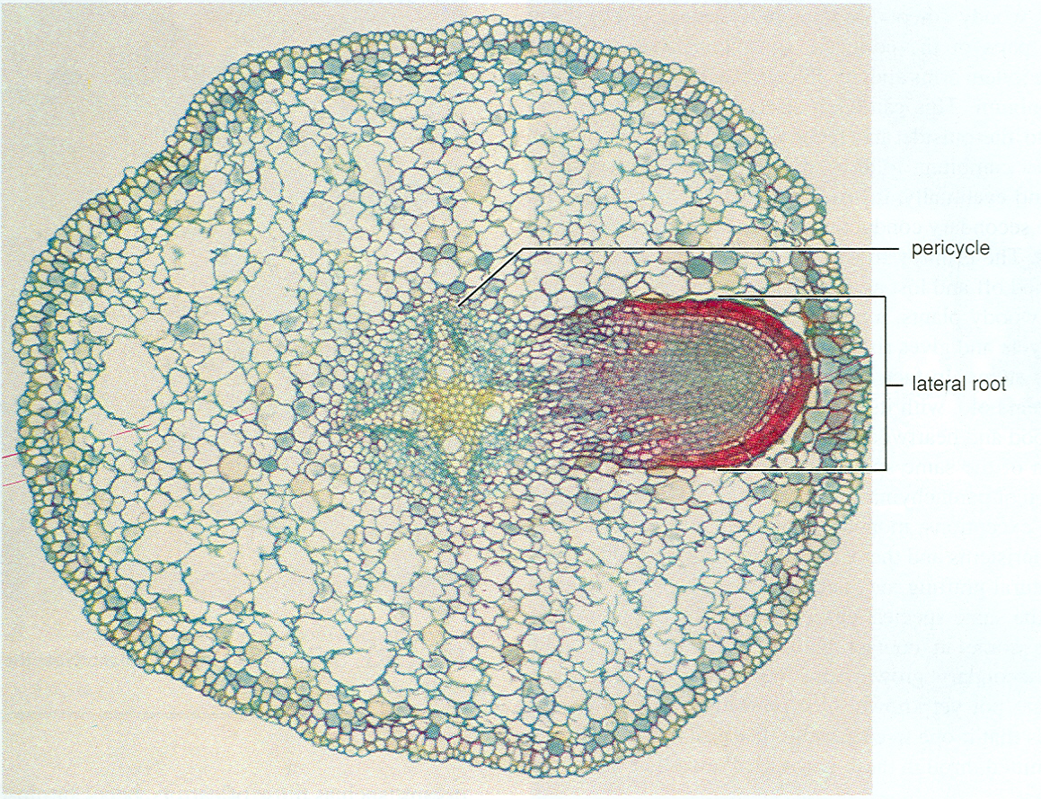

Slide 20
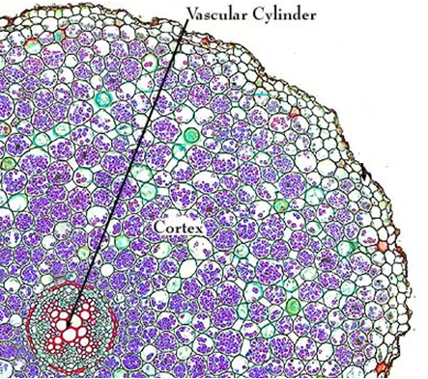
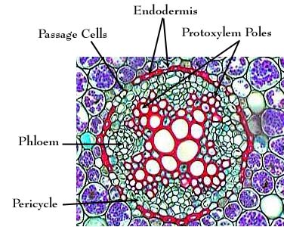
Vascular Tissue Arrangement in Zone of Maturation of Dicot Roots
T.S. Of Dicot root

Slide 21
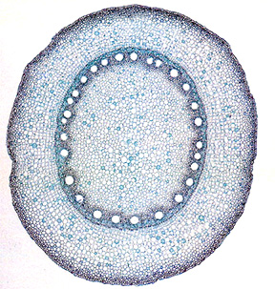
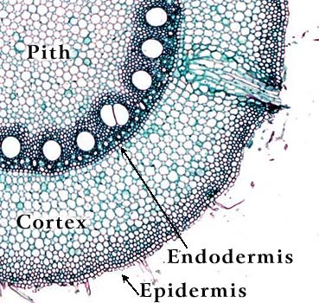
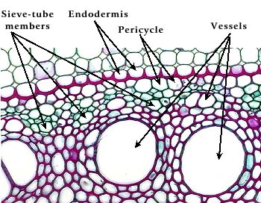
Vascular Tissue Arrangement in Zone of Maturation of Monocot Roots
T.S of Monocot Root (Zea mays)
Phloem
xylem

Slide 22
Functions of Roots
Both the tap root and fibrous root systems may undergo certain modifications to perform special functions.
Normal Functions
Special Functions
Anchorage
Physiological- absorption and conduction
Storage of food
Support
Climbing
Obtaining moisture from air
Gaseous exchange
Buoyancy

Slide 23
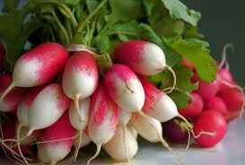
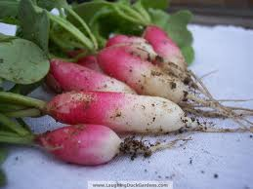
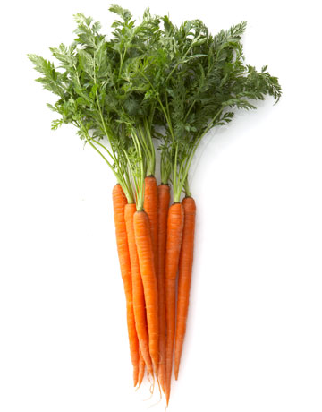
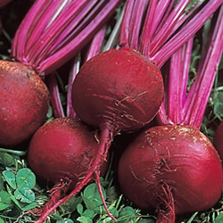
Plants with roots modified for food storage
Radish
Carrot
Beetroot

Slide 24
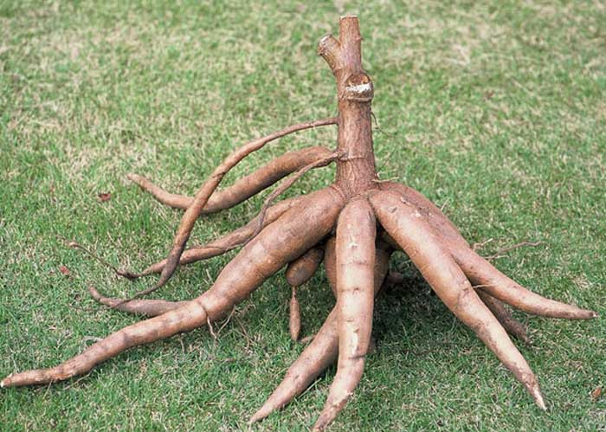
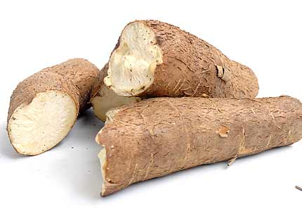
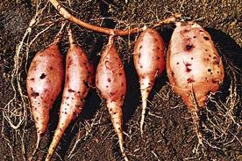
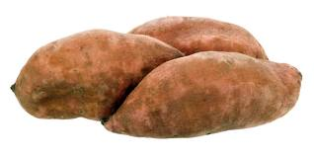
Cassava
Sweet Potato

Slide 25
Aerial Root Modifications
Aerial roots are adventitious roots which originate from aerial parts of the plant to perform various special functions.

Slide 26
For Mechanical Support
Prop/Stilt roots e.g., Zea mays, Rhizophora sp., Ficus benghalensis
In maize, the prop roots arise from the lowest nodes close to the soil surface. They form later during the growth of the plant and provide extra support.
In Rhizophora (Red Mangrove), the adventitious roots arise from the lower part of the main stem and grow obliquely towards the soil. They serve to keep the plant erect by giving additional support.
In Ficus, they arise from the horizontal branches and grow vertically downwards. After reaching the soil they become thick and woody. Thus, they function as pillars giving mechanical support to the heavy branches. Hence, they are also known as columnar roots.
Climbing roots or clinging roots e.g., black pepper, pothos, etc : These roots arise from the nodes and help in attaching the climbing stem firmly to a support like a tree or a wall, by various mechanisms.

Slide 27
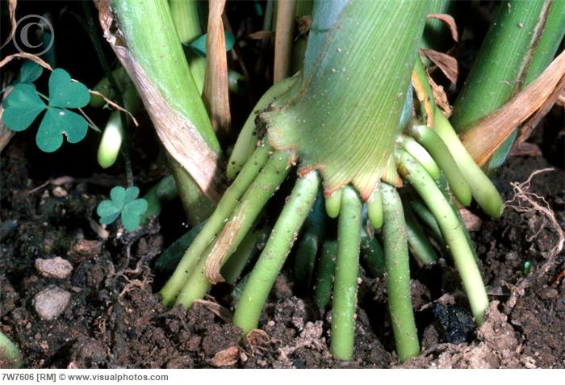
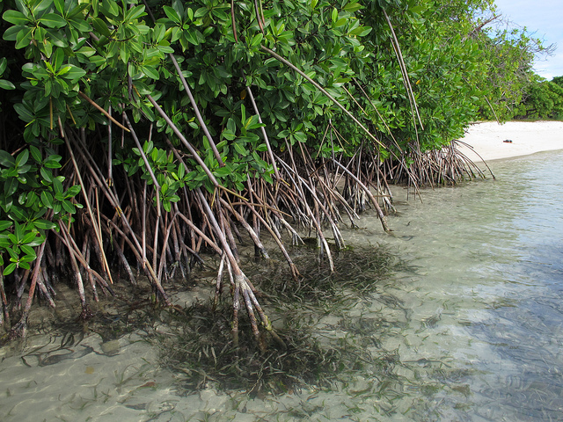
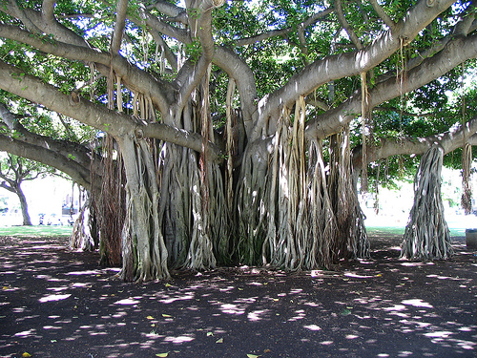
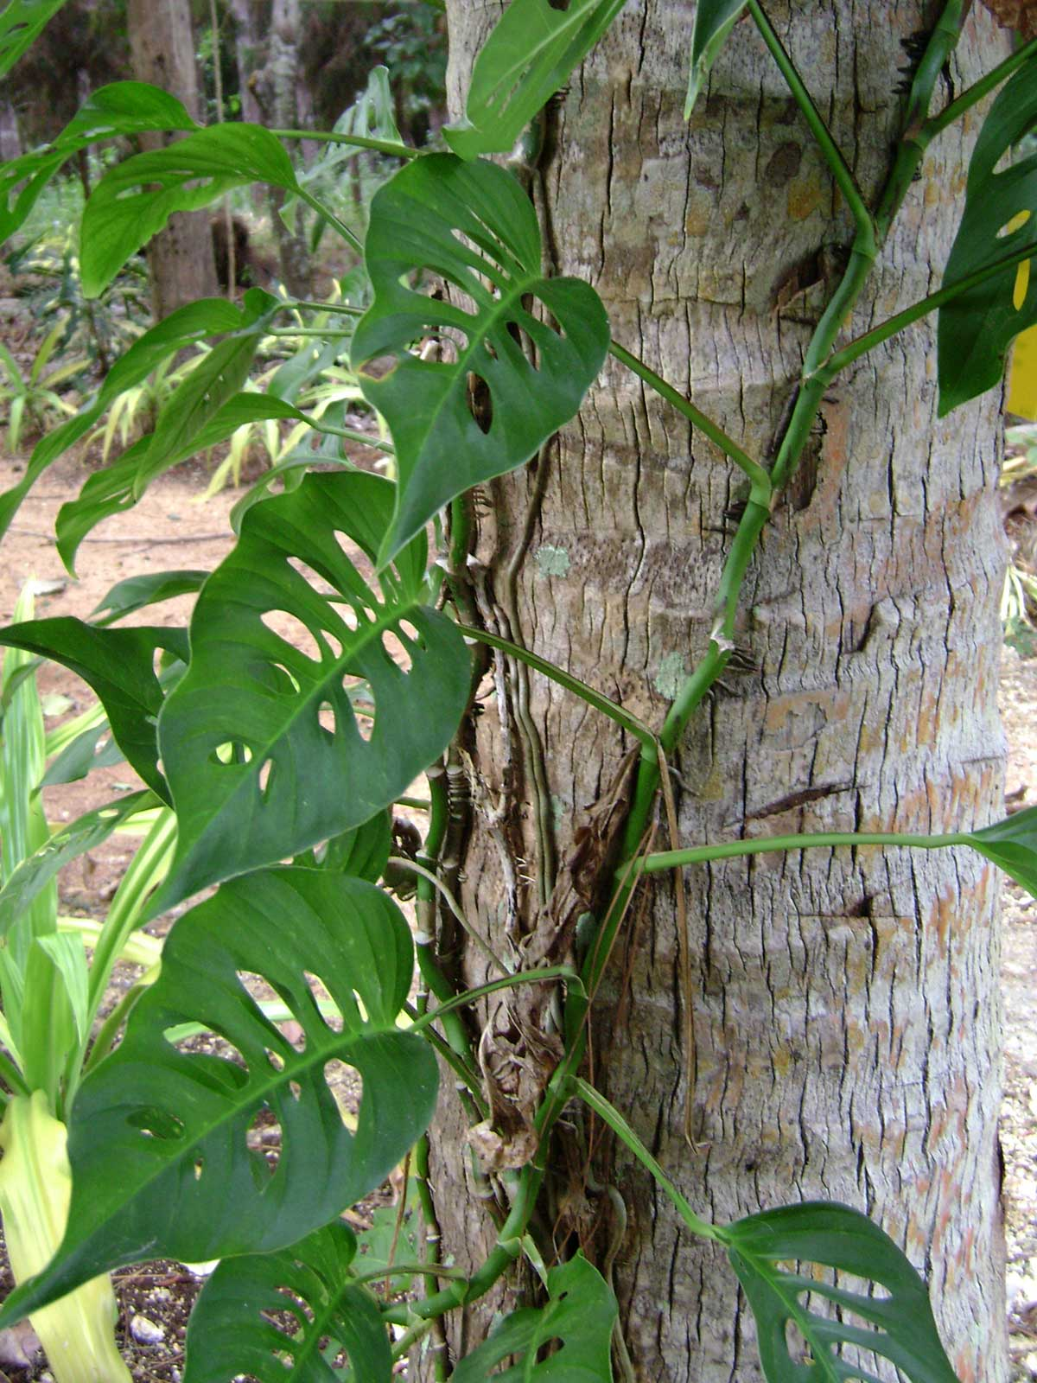
Maize
Rhizophora
Prop/Stilt roots
Ficus
Monstera
Climbing roots

Slide 28
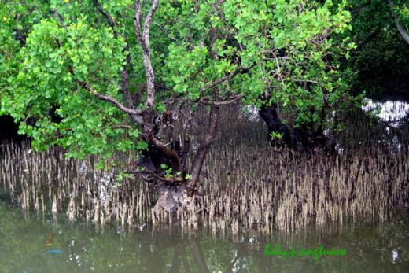
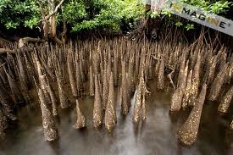
FOR GASEOUS EXCHANGE
Breathing roots or pneumtophores.
A number of plants growing in marshy or water-logged soils which contain almost no air, develop some roots which grow vertically upwards into the air. These roots are called breathing roots or pneumatophores. Each root has numerous pores at the apex through which gases diffuse in and out.

Slide 29
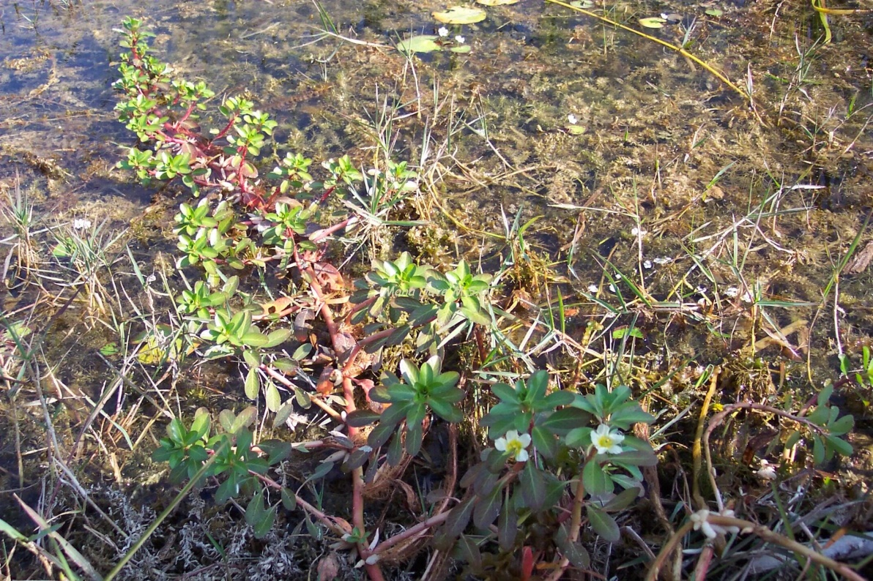
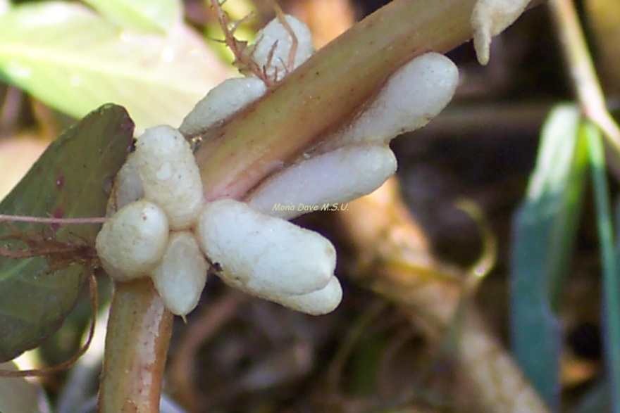
FOR BUOYANCY
Floating roots e.g., Jussiaea:
In Jussiaea which is an aquatic plant, special spongy roots called floating roots arise from nodes of the stem. They are adventitious and enclose parenchyma cells with large air spaces (aerenchyma). These roots usually develop above the level of water and serve to store up air and help in buoyancy of the plant.

Slide 30
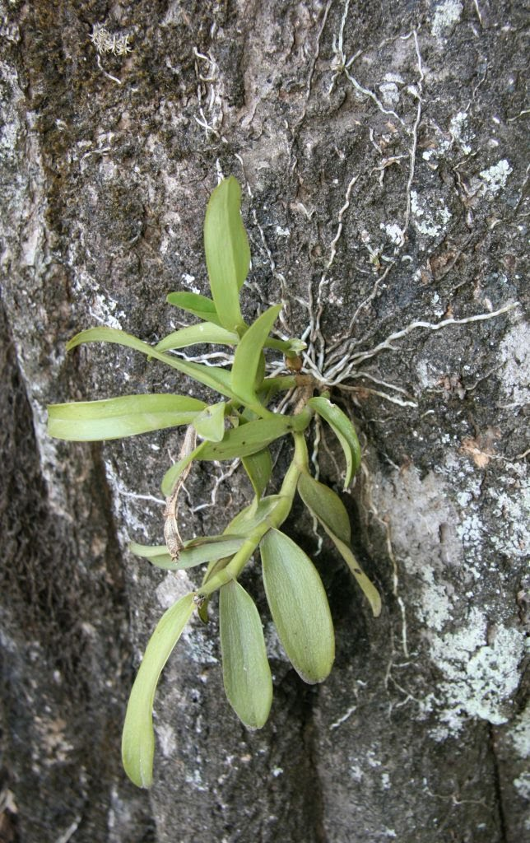
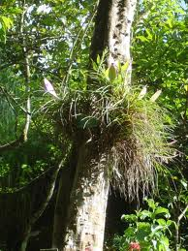
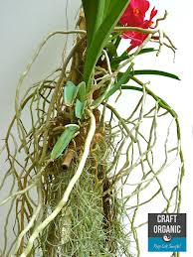
FOR ABSORPTION OF MOISTURE
Epiphytic roots, e.g., Vanda:
In epiphytes like orchids which grow on other plants, special adventitious roots called epiphytic roots are produced. The outer region of the root is made up of a special tissue called the velamen. This tissue absorbs moisture from the air and makes it available to the plant. These roots do not penetrate the host tissue like parasitic roots.

